Slide 1
For each of the diagrams shown in the later slides, you can find the associated PlantUML scripts in the notes.

Slide 2
Use Case Diagram (cont.)
Use Case Relationship:
Generalization: indicates one use case is a special kind of another.
Represented by a directed arrow with a triangle arrowhead.
Indicates a parent-child relationship between use cases.
The child use case is connected at the base of the arrow, while the tip of the arrow is connected to the parent use case.
Generalization is used when we find two or more use cases that have commonalities in behavior, structure, and purpose.
Notes:
@startuml
actor Customer as CS
actor "Internet Customer" as ICS
rectangle "Apple Store" {
usecase "Place Order in Store" as PRS
usecase "Place Order Online" as PRO
usecase "Place Order" as PO
}
PO <|-- PRS
PO <|-- PRO
CS-- PRS
ICS -- PRO
@enduml

Slide 3
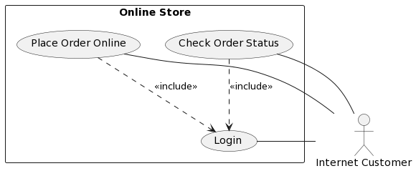
Use Case Diagram (cont.)
Use Case Relationship:
Include: indicates one use case (the base use case) is using the functionality of another use case (the inclusion use case).
Represented by a directed arrow with dotted line.
The stereotype “<<include>>” identifies the include relationship, where the base use case includes the functionality of the inclusion use case.
Include relation is used to support the reuse of functionality in a use-case model.
Notes:
@startuml
actor "Internet Customer" as ICS
rectangle "Online Store" {
usecase "Login" as LG
usecase "Place Order Online" as PRO
usecase "Check Order Status" as COS
}
PRO ..> LG: <<include>>
COS ..> LG: <<include>>
ICS-- LG
ICS-- PRO
ICS-- COS
@enduml

Slide 4
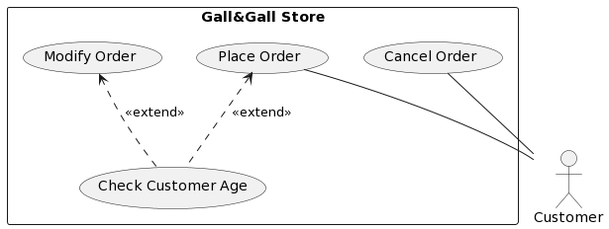
Use Case Diagram (cont.)
Use Case Relationship:
Extend: specify that one use case (extension) extends the behavior of another use case (base).
Represented by a directed arrow with dotted line. The stereotype “<<extend>>” identifies the extend relationship.
The extension owns the extend relationship, and we can specify several extend relationships for a single base use case.
We use extend relationship to show:
A use case is an optional system behavior.
A use case is executed only under certain conditions.
Notes:
@startuml
actor Customer as CS
rectangle "Gall&Gall Store" {
usecase "Place Order" as PO
usecase "Check Customer Age" as CCA
usecase "Cancel Order" as CO
usecase "Modify Order" as MO
}
PO<.. CCA: <<extend>>
MO<.. CCA: <<extend>>
CS -up- PO
CS -up- CO
@enduml

Slide 5
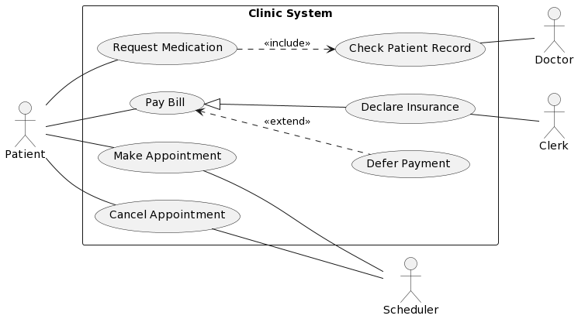
Use Case Diagram (cont.)
An overall example:
Include
Generalization
Extend
Association
Notes:
@startuml
left to right direction
actor Patient as PT
actor Scheduler as SC
actor Doctor as DC
actor Clerk as CL
rectangle "Clinic System" {
usecase "Cancel Appointment" as UC1
usecase "Make Appointment" as UC2
usecase "Request Medication" as UC3
usecase "Check Patient Record" as UC4
usecase "Pay Bill" as UC5
usecase "Defer Payment" as UC6
usecase “Declare Insurance" as UC7
}
PT -- UC1
PT -- UC2
PT -- UC3
PT -- UC5
UC1 -- SC
UC2 -- SC
UC3 ..> UC4 : <<include>>
UC5 <|-- UC7
UC5 <.. UC6 : <<extend>>
UC4 -- DC
UC7 -- CL
@enduml

Slide 6
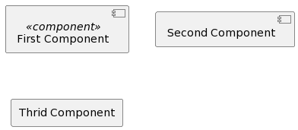
Component Diagram (cont.)
Common elements in the diagram:
Component: represents a modular part of a system that encapsulates its contents. It can be represented by different ways:
A rectangle with the stereotype <<component>> and/or icon.
A rectangle with the component icon.
A rectangle with the name of the component.
Notes:
@startuml
component "First Component" <<component>>
component "Second Component"
skinparam componentStyle rectangle
component "Thrid Component"
@enduml

Slide 7
Component Diagram (cont.)
Common elements in the Component Diagram:
Assembly:
Provided interface: symbols with a complete circle at the end represent an interface
Required interface: symbols with a half circle at the end represent an interface that the component requires.
Provided Interface
Required interface
Notes:
@startuml
interface "Student ID" as SID1
interface "Student ID" as SID2
interface "Student Profile" as SP
component "Study Report Generator" as SRG
component "Student Profile Finder" as SPF
component "Bachelor Student Database" as BSD
component "Master Student Database" as MSD
SID1 -left- BSD
SID2 -left- MSD
SP -left- SPF
SPF -down-( SID1
SPF -left-( SID2
SRG -left-( SP
@enduml

Slide 8
Component Diagram (cont.)
Common elements in the Component Diagram:
Dependency:
Indicates that the functioning of one element depends on the existence of another element. (Thinking about the #include statement)
Dependency
Notes:
@startuml
component "Study Report Generator" as SRG
component "Student Profile Finder" as SPF
component "Student Database" as SD
SRG .right.> SPF: use
SPF .right.> SD: search in
@enduml

Slide 9
Component Diagram (cont.)
Common elements in the Component Diagram:
Group and package:
Notes:
@startuml
interface "Student ID" as SID1
interface "Student ID" as SID2
package "Student Management Subsystem" {
component "Student Profile Finder" as SIF
component "Study Report Generator" as SRG
}
database "Student Database" {
component "Bachelor Student Database" as BSD
component "Master Student Database" as MSD
}
SID1 -down- MSD
SID2 -down- BSD
SIF -( SID1
SIF -( SID2
SRG .right.> SIF: use
@enduml

Slide 10
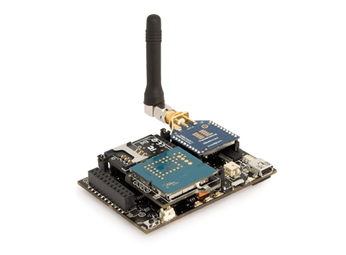
Deployment Diagram (cont.)
Modeling a wireless sensing system:
Node
Connection
Notes:
@startuml
node "Wireless Transceiver" <<hardware>> as WT {
}
node "Power Source" <<hardware>> as PS{
}
node "Wireless Driver" <<software>> as WD{
}
node "Sensor" <<hardware>> as SS{
}
node "Micro-controller" <<hardware>> as MC{
}
node "Cloud Server" <<software>> as CS{
}
PS-MC: Cable
MC-SS: ADC
MC-up-WD
WD-left-WT
WT-left-CS: WiFi
@enduml

Slide 11
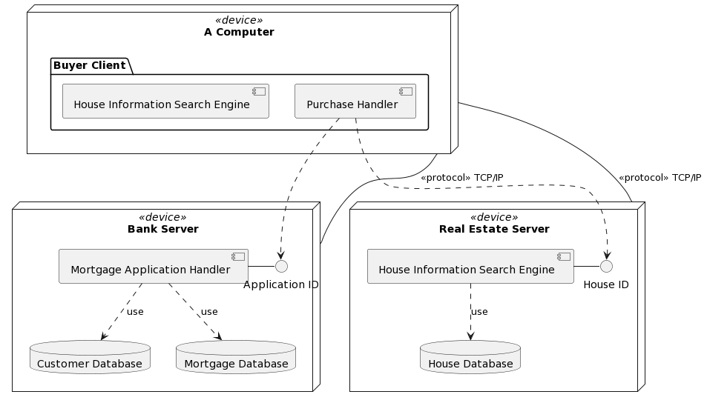
Deployment Diagram (cont.)
Another example:
Communication
Node
Dependency
Notes:
@startuml
node "Bank Server" <<device>> as BS {
database "Customer Database" as CD
database "Mortgage Database" as MD
component "Mortgage Application Handler" as MA
interface "Application ID" as AI
MA-AI
MA ..> CD: use
MA ..> MD: use
}
node "Real Estate Server" <<device>> as RES {
database "House Database" as LD
component "House Information Search Engine" as L
interface "House ID" as LI
L-LI
L ..> LD: use
}
node "A Computer" <<device>> as AC {
package "Buyer Client" {
component "Purchase Handler" as BC
component "House Information Search Engine"
}
}
AC-down-BS: <<protocol>> TCP/IP
BC .>AI
AC-down-RES: <<protocol>> TCP/IP
BC .>LI
@enduml

